Slide 1

Python
~ Pankaj

Slide 2
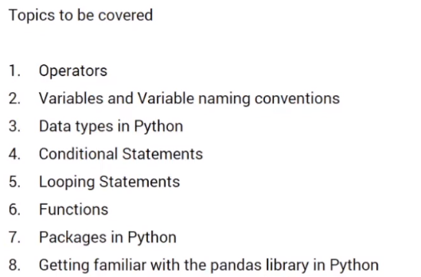
Python - Basics

Slide 3
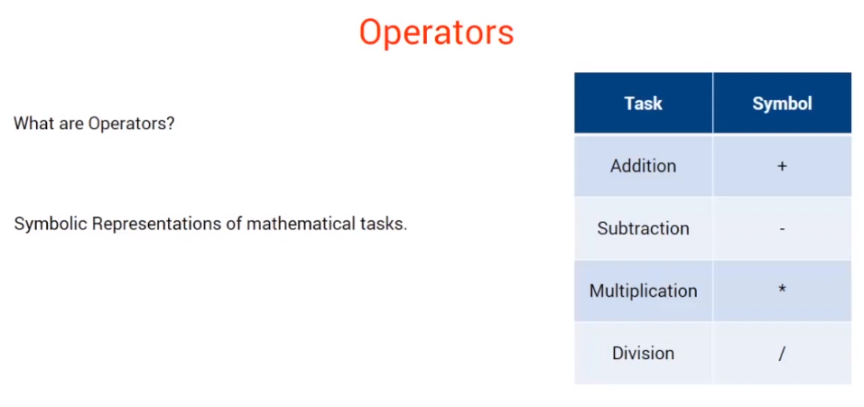
Python - Operators

Slide 4
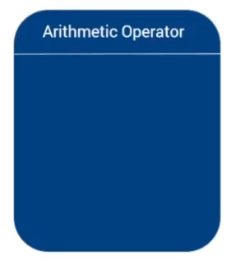
Python – Different Types of Operators

Slide 5
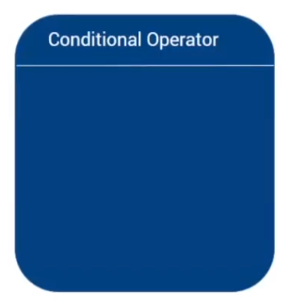
Python – Different Types of Operators

Slide 6
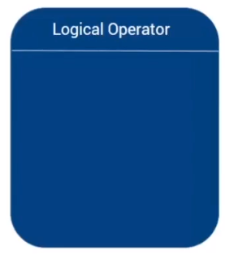
Python – Different Types of Operators

Slide 7
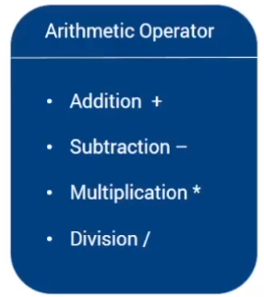
Python - Different Types of Operators

Slide 8
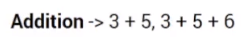
Python - Different Types of Operators

Slide 9
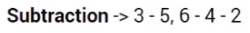
Python - Different Types of Operators

Slide 10
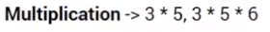
Python - Different Types of Operators

Slide 11
Python - Different Types of Operators

Slide 12
Python - Different Types of Operators
Return type depends on the operands

Slide 13
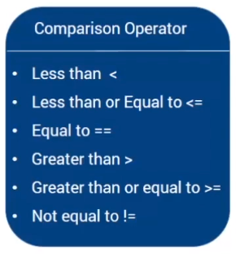
Python - Different Types of Operators

Slide 14
Python - Different Types of Operators

Slide 15
Python - Different Types of Operators

Slide 16
Python - Different Types of Operators

Slide 17
Python - Different Types of Operators

Slide 18
Python - Different Types of Operators

Slide 19
Python - Different Types of Operators

Slide 20
Python - Different Types of Operators
Return only TRUE or FALSE

Slide 21
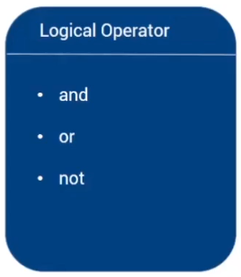
Python - Different Types of Operators

Slide 22
Python - Different Types of Operators

Slide 23
Python - Different Types of Operators

Slide 24
Python - Different Types of Operators

Slide 25
Python - Different Types of Operators

Slide 26
Python - Different Types of Operators

Slide 27
Python - Different Types of Operators

Slide 28
Python - Different Types of Operators
and, or returns on of the operands
not returns only True or False

Slide 29
Python - Operators
What does the // operator do ?
A – Gives Remainder
B – Gives Division
C – None of the above
Which Option will give you remainder ?
A : /
B : %
C : //
D : %%
We can do mathematical operation on String
A : True
B : False

Slide 30
Python – Variable & Data Types

Slide 31
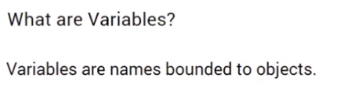
Python – Variable

Slide 32
Python – Variable
Name = ‘Pankaj’
Age = 35
Experience = 10.5

Slide 33
Python – Variable
Name = ‘Pankaj’
Age = 35
Experience = 10.5
Variable

Slide 34
Python – Variable
Name = ‘Pankaj’
Age = 35
Experience = 10.5
Variable
Value / Object

Slide 35
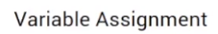
Python - Variable

Slide 36
Python - Variable
Variable_Name = Variable_Value

Slide 37
Python - Variable
Variable_Name = Variable_Value
dog_name = ‘Freddie‘
age = 2
is_vaccinated = True height = 1.1
birth_year = 2019
If we type the variable name, then value will be returned

Slide 38
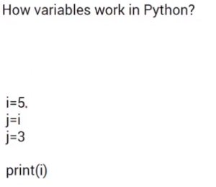
Python - Variable

Slide 39
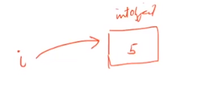
Python - Variable

Slide 40
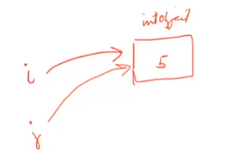
Python - Variable

Slide 41
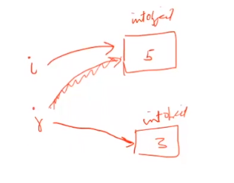
Python - Variable

Slide 42
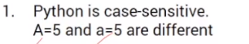
Python – Variable Naming Rules

Slide 43
Python – Variable Naming Rules

Slide 44
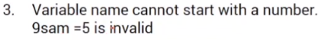
Python – Variable Naming Rules

Slide 45
Python – Data Types
Once we choose the name, we can use it store different types of data.

Slide 46
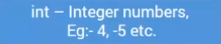
Python – Data Types
Once we choose the name, we can use it store different types of data.

Slide 47
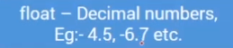
Python – Data Types
Once we choose the name, we can use it store different types of data.

Slide 48
Python – Data Types
There are three numeric types in Python:
int
float
Complex
Variables of numeric types are created when you assign a value to them
x = 1 # int
y = 2.8 # float
z = 1j # complex

Slide 49
Python – Data Types
Type Conversion
We can convert from one type to another with the int(), float() and complex()
x = 1 # int y = 2.8 # float z = 1j # complex

Slide 50
Python – Data Types
Type Conversion
We can convert from one type to another with the int(), float() and complex()
x = 1 # int y = 2.8 # float z = 1j # complex
#convert from int to float: a = float(x)

Slide 51
Python – Data Types
Type Conversion
We can convert from one type to another with the int(), float() and complex()
x = 1 # int y = 2.8 # float z = 1j # complex
#convert from int to float: a = float(x)
#convert from float to int: b = int(y)

Slide 52
Python – Data Types
Type Conversion
We can convert from one type to another with the int(), float() and complex()
x = 1 # int y = 2.8 # float z = 1j # complex
#convert from int to float: a = float(x)
#convert from float to int: b = int(y)
#convert from int to complex: c = complex(x)

Slide 53
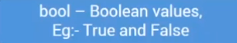
Python – Data Types
Once we choose the name, we can use it store different types of data.

Slide 54
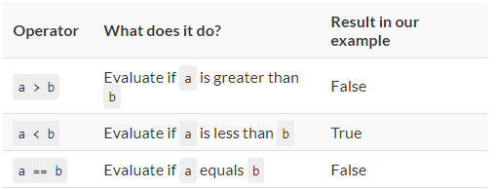
Python – Data Types : Basic Boolean Operators
If a = TRUE and b = FALSE

Slide 55
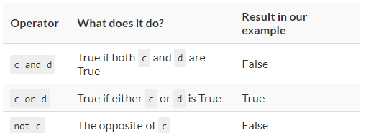
Python – Data Types : Basic Boolean Operators
If c = TRUE and d = FALSE
The evaluation order of the logical operators is:
not
and
or

Slide 56

Python – Data Types
Once we choose the name, we can use it store different types of data.

Slide 57
Python – Data Types
String literals in python are surrounded by either single quotation marks, or double quotation marks.
i.e. 'hello' is the same as "hello"

Slide 58
Python – Data Types
String literals in python are surrounded by either single quotation marks, or double quotation marks.
i.e. 'hello' is the same as "hello"
Assign String to a Variable : a = "Hello World“
Multiline Strings : b = “””Hello, ……………
…………………. how are you?“””

Slide 59
Python – Data Types
String literals in python are surrounded by either single quotation marks, or double quotation marks.
i.e. 'hello' is the same as "hello"
Assign String to a Variable : a = "Hello World“
Multiline Strings : b = “””Hello, ……………
…………………. how are you?“””
Strings are array: print(a[1])

Slide 60
Python – Data Types
String literals in python are surrounded by either single quotation marks, or double quotation marks.
i.e. 'hello' is the same as "hello"
Assign String to a Variable : a = "Hello World“
Multiline Strings : b = “””Hello, ……………
…………………. how are you?“””
Strings are array: print(a[1])
Slicing : print(a[1:3])

Slide 61
Python – Data Types
String literals in python are surrounded by either single quotation marks, or double quotation marks.
i.e. 'hello' is the same as "hello"
Assign String to a Variable : a = "Hello World“
Multiline Strings : b = “””Hello, ……………
…………………. how are you?“””
Strings are array: print(a[1])
Slicing : print(a[1:3])
Negative Indexing : print(a[-5: -3])

Slide 62
Python – Data Types
String literals in python are surrounded by either single quotation marks, or double quotation marks.
i.e. 'hello' is the same as "hello"
Assign String to a Variable : a = "Hello World“
Multiline Strings : b = “””Hello, ……………
…………………. how are you?“””
Strings are array: print(a[1])
Slicing : print(a[1:3])
Negative Indexing : print(a[-5: -3])
String Length : print(len(a))

Slide 63
Python – Data Types
String literals in python are surrounded by either single quotation marks, or double quotation marks.
i.e. 'hello' is the same as "hello"
Assign String to a Variable : a = "Hello World“
Multiline Strings : b = “””Hello, ……………
…………………. how are you?“””
Strings are array: print(a[1])
Slicing : print(a[1:3])
Negative Indexing : print(a[-5: -3])
String Length : print(len(a))
Check String : > x = ‘ll’ in a or x = ‘am’ not in a
> print(a[1])

Slide 64
Python – Data Types
String literals in python are surrounded by either single quotation marks, or double quotation marks.
i.e. 'hello' is the same as "hello"
Assign String to a Variable : a = "Hello World“
Multiline Strings : b = “””Hello, ……………
…………………. how are you?“””
Strings are array: print(a[1])
Slicing : print(a[1:3])
Negative Indexing : print(a[-5: -3])
String Length : print(len(a))
Check String : > x = ‘ll’ in a or x = ‘am’ not in a
> print(a[1])
String Concatenation : a + b or a + “ “ + b

Slide 65
Python – Data Types
String literals in python are surrounded by either single quotation marks, or double quotation marks.
i.e. 'hello' is the same as "hello"
Assign String to a Variable : a = "Hello World“
Multiline Strings : b = “””Hello, ……………
…………………. how are you?“””
Strings are array: print(a[1])
Slicing : print(a[1:3])
Negative Indexing : print(a[-5: -3])
String Length : print(len(a))
Check String : > x = ‘ll’ in a or x = ‘am’ not in a
> print(a[1])
String Concatenation : a + b or a + “ “ + b
String Format :
age = 36
txt = "My name is Rahul, and I am {}“
print(txt.format(age))

Slide 66
Python – Data Types
String literals in python are surrounded by either single quotation marks, or double quotation marks.
i.e. 'hello' is the same as "hello"
Assign String to a Variable : a = "Hello World“
Multiline Strings : b = “””Hello, ……………
…………………. how are you?“””
Strings are array: print(a[1])
Slicing : print(a[1:3])
Negative Indexing : print(a[-5: -3])
String Length : print(len(a))
Check String : > x = ‘ll’ in a or x = ‘am’ not in a
> print(a[1])
String Concatenation : a + b or a + “ “ + b
String Format :
age = 36
txt = "My name is Rahul, and I am {}“
print(txt.format(age))
Escape Character : An escape character is a backslash \ followed by the character you want to insert.
str = ‘a king\s kingdom’’

Slide 67
Python – Data Types
String literals in python are surrounded by either single quotation marks, or double quotation marks.
i.e. 'hello' is the same as "hello"
Assign String to a Variable : a = "Hello World“
Multiline Strings : b = “””Hello, ……………
…………………. how are you?“””
Strings are array: print(a[1])
Slicing : print(a[1:3])
Negative Indexing : print(a[-5: -3])
String Length : print(len(a))
Check String : > x = ‘ll’ in a or x = ‘am’ not in a
> print(a[1])
String Concatenation : a + b or a + “ “ + b
String Format :
age = 36
txt = "My name is Rahul, and I am {}“
print(txt.format(age))
Escape Character : An escape character is a backslash \ followed by the character you want to insert.
str = ‘a king\s kingdom’’
Strings Method : Python has a set of built-in methods that you can use on strings like upper(), lower()

Slide 68
Python – Data Types
String literals in python are surrounded by either single quotation marks, or double quotation marks.
i.e. 'hello' is the same as "hello"
Assign String to a Variable : a = "Hello World“
Multiline Strings : b = “””Hello, ……………
…………………. how are you?“””
Strings are array: print(a[1])
Slicing : print(a[1:3])
Negative Indexing : print(a[-5: -3])
String Length : print(len(a))
Check String : > x = ‘ll’ in a or x = ‘am’ not in a
> print(a[1])
String Concatenation : a + b or a + “ “ + b
String Format :
age = 36
txt = "My name is Rahul, and I am {}“
print(txt.format(age))
Escape Character : An escape character is a backslash \ followed by the character you want to insert.
str = ‘a king\s kingdom’’
Strings Method : Python has a set of built-in methods that you can use on strings like upper(), lower()

Slide 69
Python – Data Types
Once we choose the name, we can use it store different types of data.

Slide 70
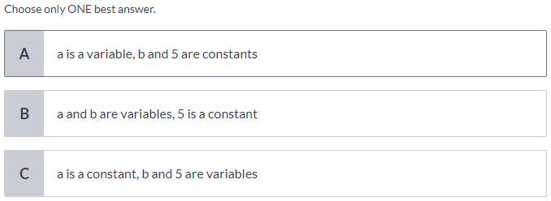
Python – Data Types

Slide 71
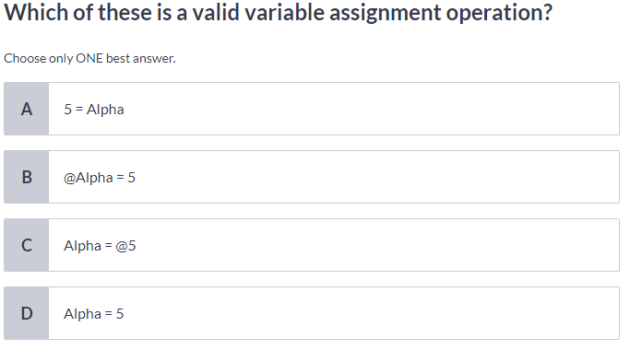
Python – Data Types

Slide 72
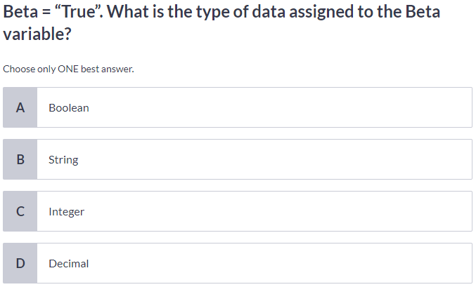
Python – Data Types

Slide 73
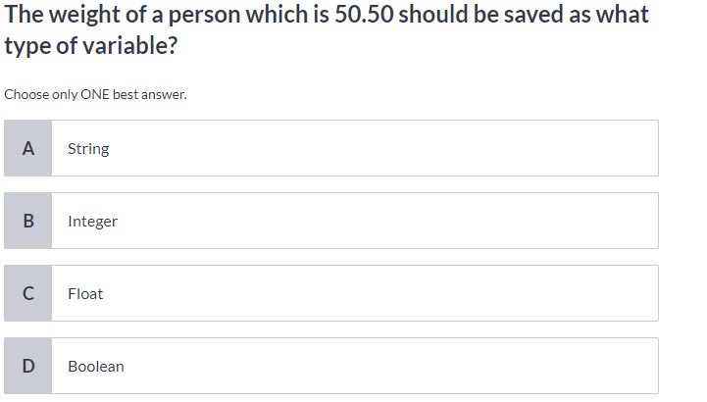
Python – Data Types

Slide 74
Python – Conditional Statements

Slide 75
Python – Conditional Statements
We use if statements in our everyday life all the time – even if our everyday life is not written in Python.
e.g. If the light is green then I’ll cross the road; otherwise I’ll wait.

Slide 76
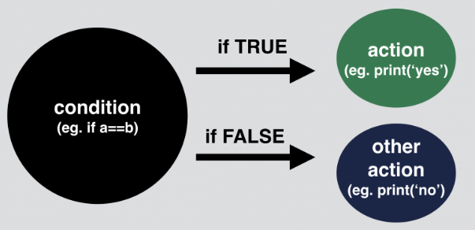
Python – Conditional Statements
We use if statements in our everyday life all the time – even if our everyday life is not written in Python.
e.g. If the light is green then I’ll cross the road; otherwise I’ll wait.

Slide 77
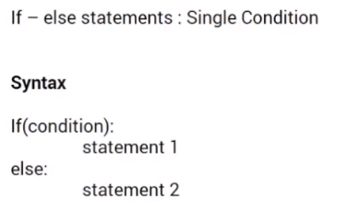
Python – Conditional Statements

Slide 78
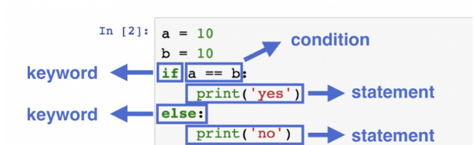
Python – Conditional Statements
If statement syntax:

Slide 79
Python – Conditional Statements
If statement syntax:
an if keyword, then
a condition, then
a statement, then
an else keyword, then
another statement.

Slide 80
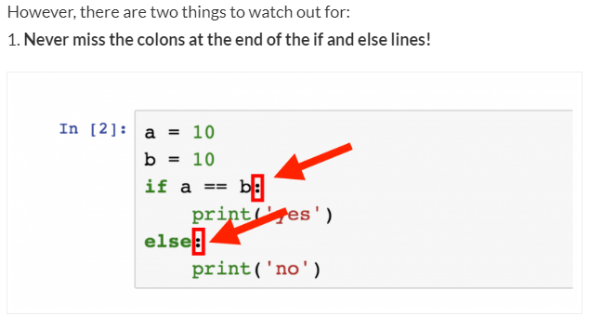
Python – Conditional Statements

Slide 81
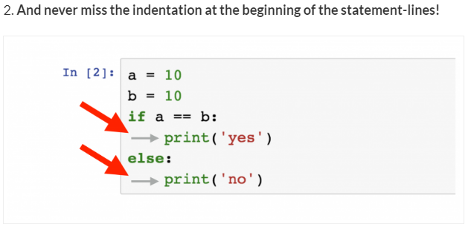
Python – Conditional Statements
If you miss any of the above two, an error message will be returned saying “invalid syntax” and your Python script will fail.

Slide 82
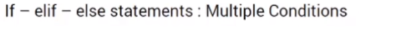
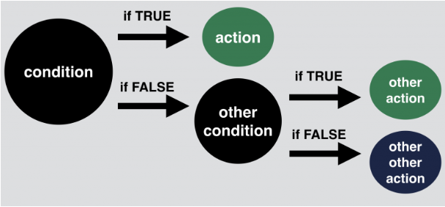
Python – Conditional Statements

Slide 83
Python – Conditional Statements

Slide 84
Python – Conditional Statements
a = 10
b = 11
c = 10
if a == b:
print('first condition is true')
elif a == c:
print('second condition is true')
else:
print('nothing is true. existence is pain.')

Slide 85
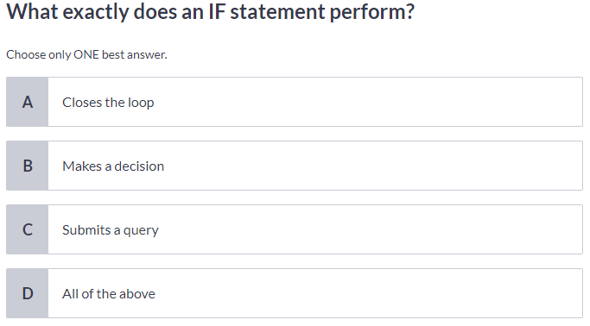
Python – Conditional Statements

Slide 86
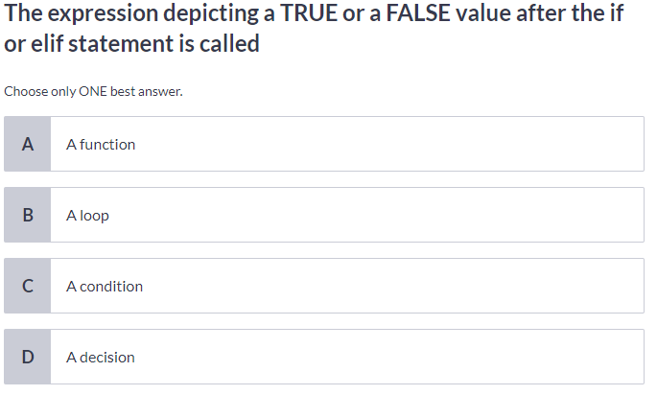
Python – Conditional Statements

Slide 87
Python – To Do

Slide 88
Python – To Do

Slide 89
Python – H.W
Here’s a random integer: 918652728452151.
First, I’d like to know 2 things about this number:
Is it divisible by 17? Does it have more than 12 digits?
If both of these conditions are true, then I want to print “super17“.
And if either of the conditions are false, then I’d like to run a second test on it:
Is it divisible by 13? Does it have more than 10 digits?
If both of these two new conditions are true, then I want to print “awesome13“.
And
if the original number is not classified as “super17” nor “awesome13“,
then I’ll just print: “oops, this is just an average random number“.
So: is 918652728452151 a super17, an awesome13 or just an average random number?

Slide 90
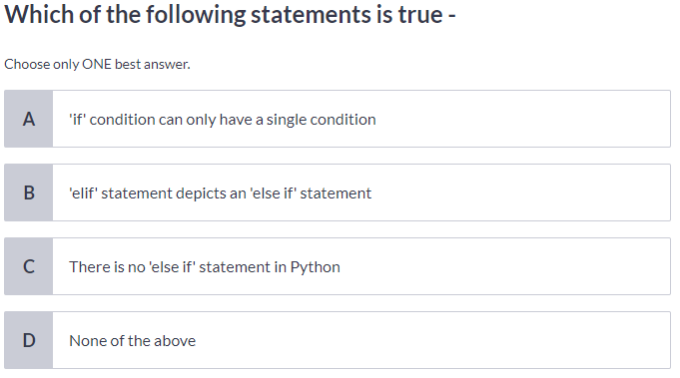
Python – Conditional Statement

Slide 91
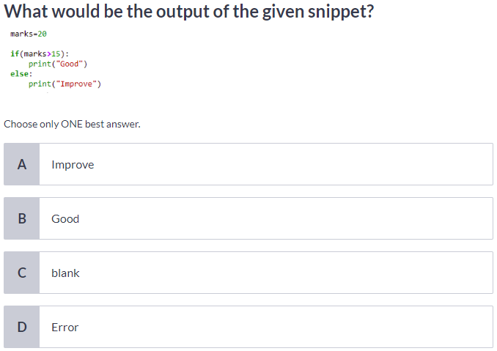
Python – Conditional Statement

Slide 92
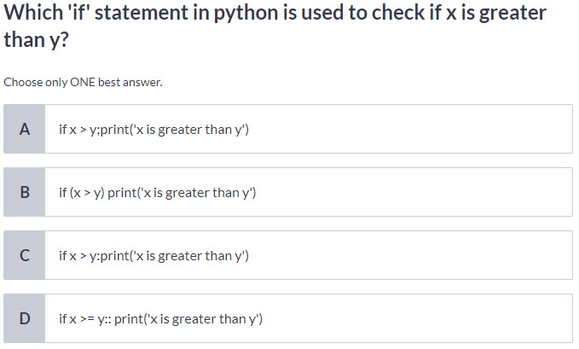
Python - Conditional Statement

Slide 93
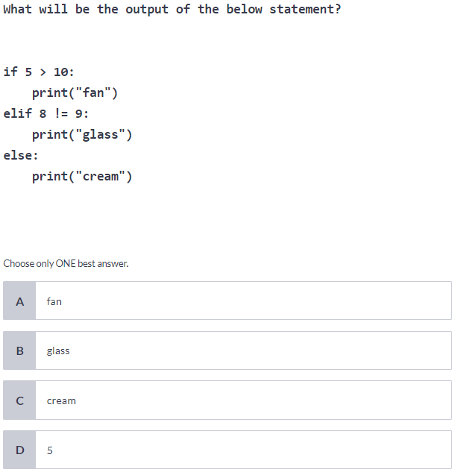
Python - Conditional Statement

Slide 94
Python – Looping Constructs

Slide 95
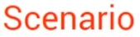
Python – Looping Constructs

Slide 96
Python – Looping Constructs

Slide 97
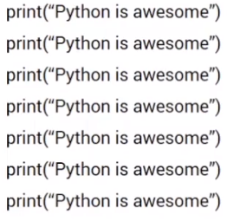
Python – Looping Constructs

Slide 98
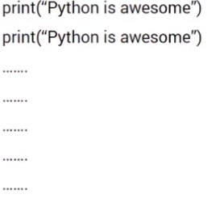
Python – Looping Constructs

Slide 99
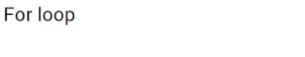
Python – Looping Constructs
for loops are used for iterating through “iterables”.
Most of the time these “iterables” will be well-known data types: lists, strings or dictionaries.
Sometimes they can also be range() objects.

Slide 100
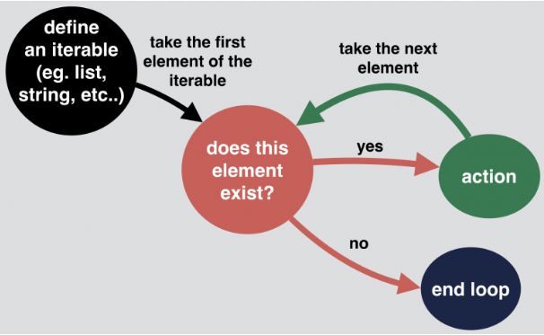
Python – Looping Constructs
for loops are used for iterating through “iterables”.
Most of the time these “iterables” will be well-known data types: lists, strings or dictionaries.
Sometimes they can also be range() objects.

Slide 101
Python – Looping Constructs
for loops are used for iterating through “iterables”.
Most of the time these “iterables” will be well-known data types: lists, strings or dictionaries.
Sometimes they can also be range() objects.

Slide 102
Python – Looping Constructs
#Iterating through Strings
my_list = "Hello World!"
for i in my_list:
print(i)

Slide 103
Python – Looping Constructs
#Iterating through Strings
my_list = "Hello World!"
for i in my_list:
print(i)
# Iterating through Range
my_list = range(0,10)
for i in my_list:
print(i)

Slide 104
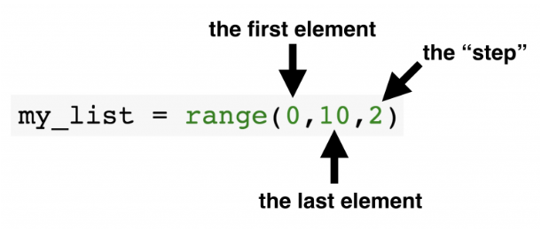
Python – Looping Constructs
#Iterating through Strings
my_list = "Hello World!"
for i in my_list:
print(i)
# Iterating through Range
my_list = range(0,10)
for i in my_list:
print(i)

Slide 105
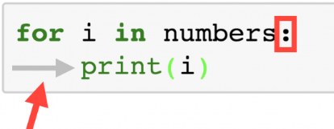
Python – Looping Constructs
Best Practise and Common Mistake:
At the end of the for line, a colon is required. And at the beginning of the lines in the loop’s body you have to use indentations.

Slide 106
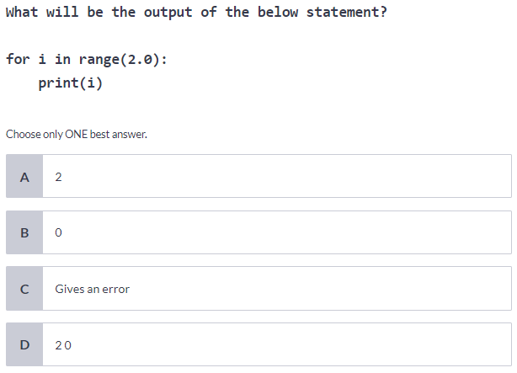
Python – Looping Constructs

Slide 107
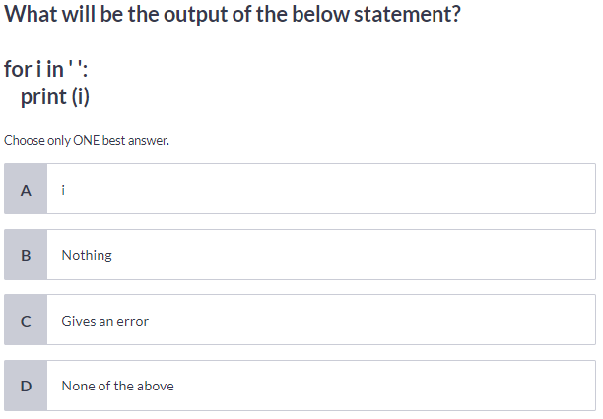
Python – Looping Constructs

Slide 108

Python – Looping Constructs

Slide 109
Python – Looping Constructs

Slide 110

Python – Looping Constructs

Slide 111

Python – Looping Constructs

Slide 112
Python – To Do
Take a variable and assign a random string to it.
Then print a pyramid of the string like in this example:
my_string = "python"
OUTPUT:
p
py
pyt
pyth
pytho
python
pytho
pyth
pyt
py
p

Slide 113
Python – Nested For Loop
Nested For Loop: for loop inside for loop
Example:
my_movies = [ ['How I Met Your Mother', 'Friends', 'Silicon Valley'],
['Family Guy', 'South Park', 'Rick and Morty'],
['Breaking Bad', 'Game of Thrones', 'The Wire'] ]
for sublist in my_movies:
for movie_name in sublist:
char_num = len(movie_name)
print("The title " + movie_name + " is " + str(char_num) + " characters long.")

Slide 114
Python –For Loop & If combined
for loop with if loop.
Go through all the numbers up until 99.
Print ‘fizz’ for every number that’s divisible by 3
Print ‘buzz’ for every number divisible by 5
Print ‘fizzbuzz’ for every number divisible by 3 and by 5!
If the number is not divisible either by 3 or 5, print a dash (‘-‘)!

Slide 115
Python –For Loop & If combined
for loop with if loop.
Go through all the numbers up until 99.
Print ‘fizz’ for every number that’s divisible by 3
Print ‘buzz’ for every number divisible by 5
Print ‘fizzbuzz’ for every number divisible by 3 and by 5!
If the number is not divisible either by 3 or 5, print a dash (‘-‘)!
for i in range(100):
if i % 3 == 0 and i % 5 == 0:
print('fizzbuzz')
elif i % 3 == 0:
print('fizz')
elif i % 5 == 0:
print('buzz')
else:
print('-')

Slide 116

Python – Functions

Slide 117

Python – Functions

Slide 118


Python – Functions

Slide 119



Python – Functions

Slide 120


Python – Functions

Slide 121

Python – Functions

Slide 122

Python – Functions
Notes:
<number>

Slide 123
Python – Functions
Notes:
<number>

Slide 124

Python – Functions
Notes:
<number>

Slide 125

Python – Functions
Notes:
<number>

Slide 126

Python – Functions
Notes:
<number>

Slide 127

Python – Functions
Notes:
<number>

Slide 128


Python – Data Structure - List

Slide 129




Python – List - (Sub-Setting)

Slide 130

Python – Data Structure - List

Slide 131

Python – Data Structure - List

Slide 132


Python – Data Structure - List

Slide 133

Python – Data Structure - List

Slide 134

Python – Data Structure - List
Notes:
a
<number>

Slide 135

Python – Data Structure - List
Notes:
a
<number>

Slide 136

Python – Data Structure - List

Slide 137

Python – Data Structure - List

Slide 138

Python – Data Structure - List

Slide 139

Python – Data Structure - Dictionary

Slide 140

Python – Data Structure - Dictionary

Slide 141

Python – Data Structure - Dictionary

Slide 142

Python – Data Structure - Dictionary

Slide 143

Python – Data Structure - Dictionary

Slide 144

Python – Data Structure - Dictionary

Slide 145


Python – Data Structure - Dictionary

Slide 146

Python – Data Structure - Dictionary

Slide 147

Python – Data Structure - Dictionary

Slide 148

Python – Data Frame

Slide 149

Python – Data Frame

Slide 150
Python
Object Orient Concept:
CLASS
VARIABLE
FUNCTION
OBJECT

